Slide 1
ES7,8,9,10,
by Yurii Holskyi

Slide 2
Javascript
What is JavaScript? According to Wikipedia, it is a scripting language that conforms to the ECMAScript specification. ES6, ES7, etc… You probably have heard those names, you also have most likely been using ES6 for a while (with Babel in a lot of cases).

Slide 3

Javascript features stages
The features go through stages from 0 to 4, 0 being the earliest stage, and 4 being “ready to release”.
Stage 0 are pure ideas someone drops, it is groomed to a Stage 1 proposal, reviewed and discussed until it reaches Stage 3, to finally be prioritized into a Stage 4. Once a feature reaches Stage 4, it is implemented in the browsers and scheduled for release.

Slide 4
EcmaScript6 (ES2015)
arrow function;
let, const;
spread and rest operators + default values;
template strings;
iterators + for … of loop;
generators;
promises;
reflect and proxy api;
9) classes;
10) modules;
11) map + weakmap, set + weaset;
12) symbols;
13) Enhanced object literals (e.g. computed properties).

Slide 5


EcmaScript7 (ES2016)
In ES7 introduced only two new features:
Array.prototype.includes();
Exponential operator (**);

Slide 6
EcmaScript8 (ES2017)
In ES8 we have:
async/await;
Object.values & Object.entries;
Trainling commas in function arguments list;
strings padding;
Object.getOwnPropertyDescriptors;
shared memory and atomics. (https://developer.mozilla.org/en-US/docs/Web/JavaScript/Reference/Global_Objects/SharedArrayBuffer)

Slide 7
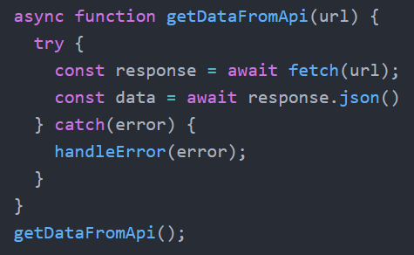
async/await
async/await it’s “syntactic sugar” for promises which used generators under the hood.

Slide 8
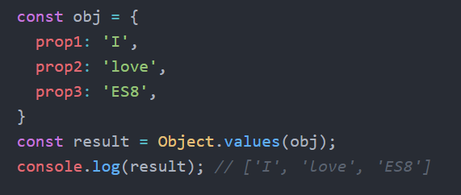
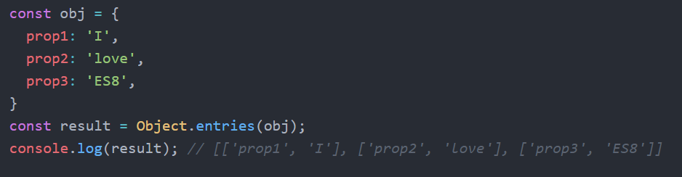
Object.values & Object.entries
Object.values returns an array of the values for all enumerable keys in the object (excluding values in the prototype chain).
The Object.entries method returns an array of arrays with the key and value in each sub-array.

Slide 9
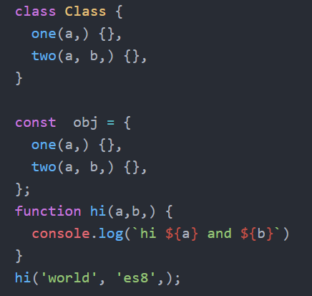
trailing commas for function
An ES8 update improving developer experience is allowing trailing commas in function parameters lists.

Slide 10
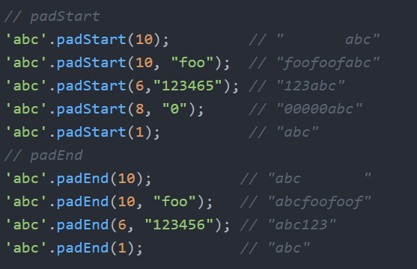
string padding
Additional functionality has been added to make strings easier to work with, and string padding ensures that the output is the exact length desired. A developer can add padding to either the beginning or end of a string with the additional string composed of a select set of characters or empty spaces.

Slide 11
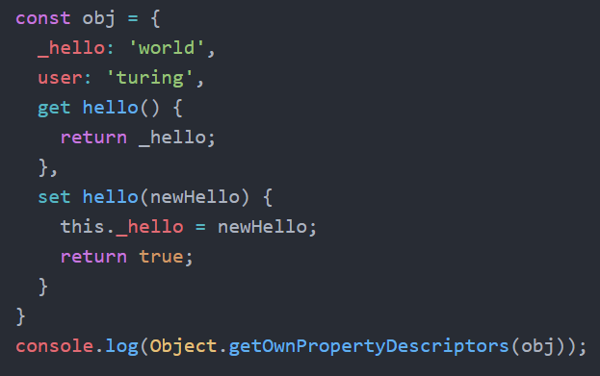
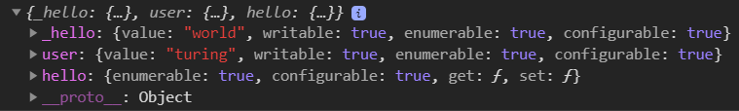
Object.getOwnPropertyDescriptors
The method returns all the own property descriptors of a given object. The property descriptors include value, writable, get, set, configurable, enumerable.

Slide 12
EcmaScript9 (ES2018)
rest & spead operators for objects;
for-await-of loop;
Promise.prototype.finally();
template literal revision;
new Regexp flags.

Slide 13
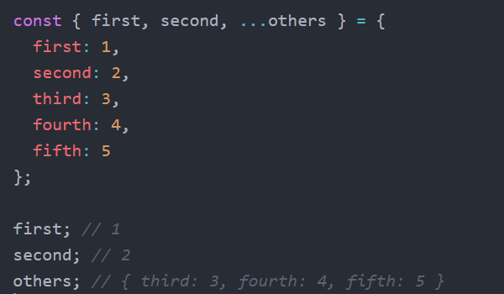

rest & spread operators
Like for arrays in ES9 we have rest and spread operators for object literals.

Slide 14
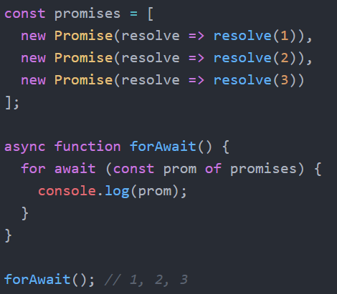
for-await-of
This loop help us work with arrays of promises. What cool that is loop await for ended all of promises.

Slide 15
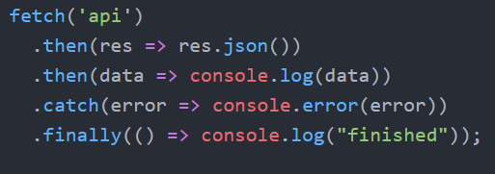
Promise.finally
Promise finally it’s additional method in then-catch chaining. In both cases (resolve or reject) finally will work.

Slide 16
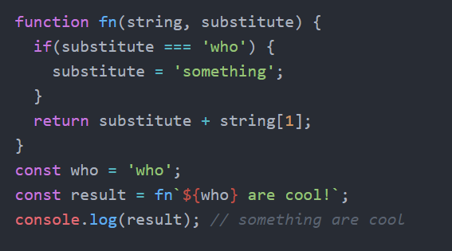
template literal revision
For detail info (https://tc39.es/proposal-template-literal-revision/)

Slide 17
EcmaScript10 (ES2019)
In ES10 we have
1) Array.prototype.flat() & Array.prototype.flatMap();
2) object.fromEntries();
3) String.prototype.trimStart() & String.prototype.trimEnd;
4) optional binding try {…} catch {…};
5) BigInt primitive type;
6) dynamic imports;
7) classes field.

Slide 18
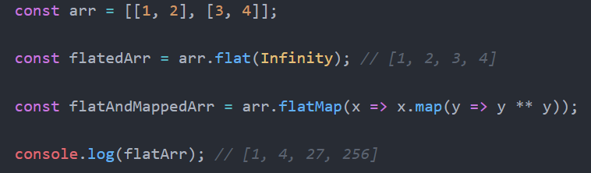
Array.flat() & Array.flatMap()
The flat method creates a new array with all sub-array elements concatenated into it recursively up to the specified depth.
The flatMap method first maps each element using a mapping function, then flattens the result into a new array. It’s identical to use Array.map().flat().

Slide 19
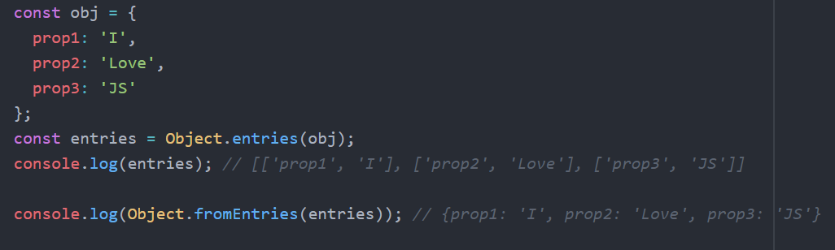
Object.fromEntries
In ES8 we have Object.entries method which returns array of key-values pair. Object.fromEntries gives us initial object.

Slide 20
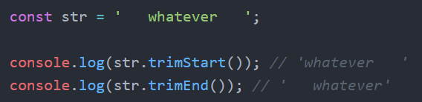
String.trimStart & String.trimEnd
In old JS we have String.prototype.trim() method. It’s two methods work the same but trimmed spaces from one side.

Slide 21
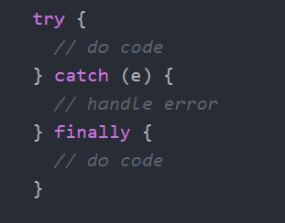
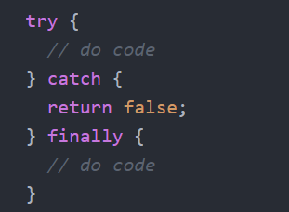
catch without parameter
In the past catch clause from a try/catch required a variable. In ES10 it’s optional.

Slide 22
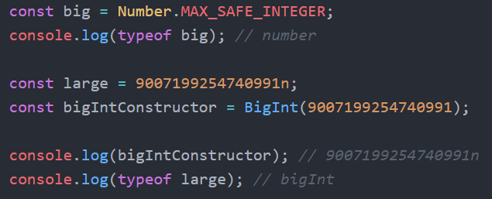
BigInt primitive (stage 3)
BigInt is the 7th primitive type and It is an arbitrary-precision integer. The variables can now represent 2⁵³ numbers and not just max out at 9007199254740992.

Slide 23
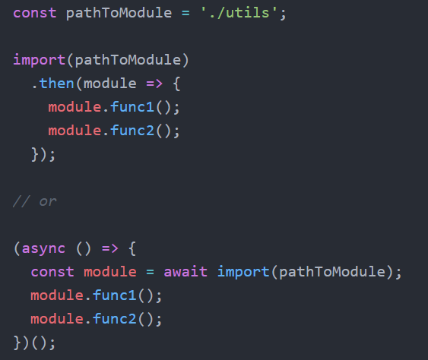
Dynamic imports (stage 3)
Dynamic imports returns a promise for the module namespace object of the requested module. Therefore, imports can now be assigned to a variable using async/await.

Slide 24
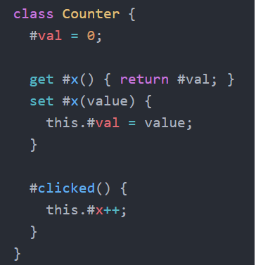
Classes field
To make methods, getter/setters or fields private, also give them a name starting with a hashtag (#)

Slide 25
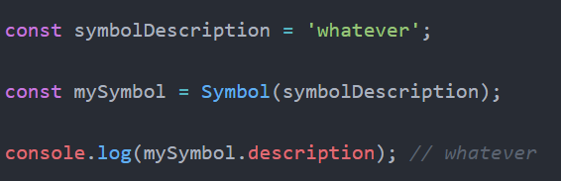

Also in ES10
Also we have Symbol.description and globalThis(stage 3) object.

Slide 26
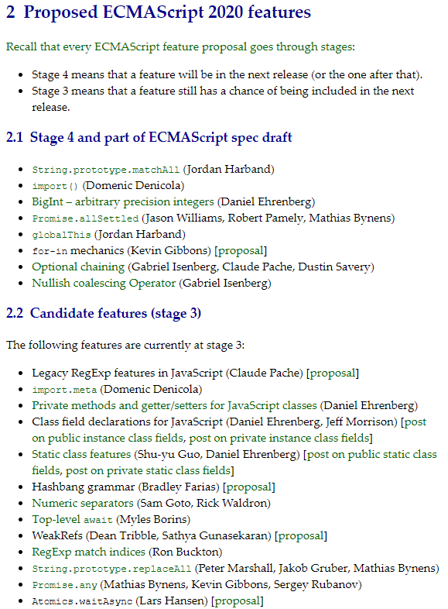
Future ES11

Slide 27
Sources
https://medium.com/@js_tut/the-complete-guide-to-es10-features-f09a8c7be1bd;
https://medium.com/better-programming/new-upcoming-javascript-features-2019-2020-and-beyond-5c426f31ec97;
https://developer.mozilla.org/en-US/docs/Web/JavaScript/Reference/Global_Objects/Array/flat;
https://tc39.es/ecma262/.

Slide 28
THANKS FOR YOUR ATTENTION.

